Slide 1

Clean Earth Map
Revolutionizing air quality awareness through real-time data and community action
We are first-year engineering students from Shetty Institute of Technology proudly participating in the NASA Space Apps Challenge 2025. This global Hackathon inspires us to use open data and technology to tackle environmental challenges, starting with air pollution.
Meet Our Team
Ayesha Siddiqa
Neha Firdous
Shreya Chavan
Zoya Amreen
MD kaif
MD Farhan

Slide 2
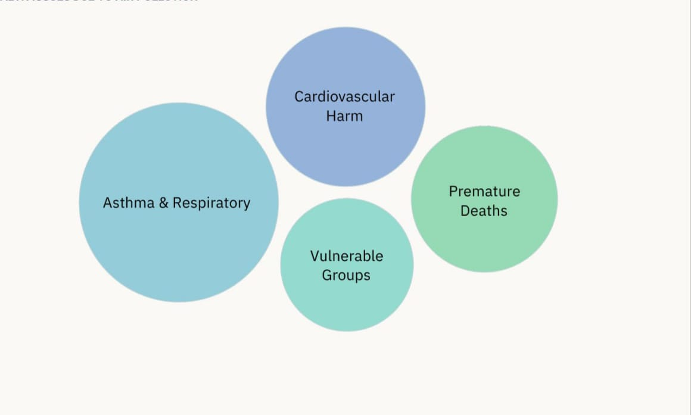
PROBLEM: HOW CAN WE REDUCE AIR POLLUTION AND ENSURE CLEANER AIR FOR EVERYONE?
HEALTH ISSUES DUE TO AIR POLLUTION

Slide 3
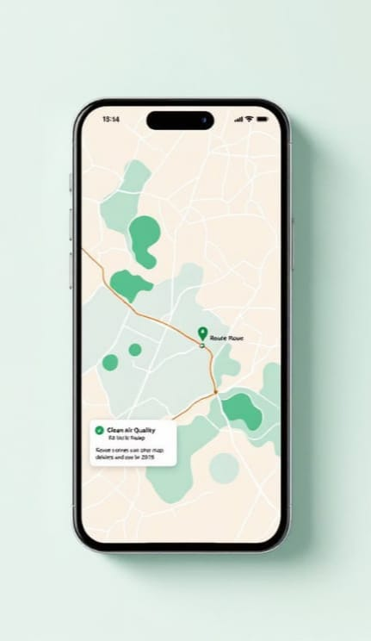
Our Solution
Clean Earth Map Platform
Interactive Mobile App
User-friendly interface with real-time map integration
Real-Time Air Quality Tracking
Live AQI data from multiple reliable sources
Pollution Hotspot Identification
Pinpoint areas with dangerous pollution levels
Smart Route Suggestions
Recommend cleaner paths for daily commuting

Slide 4
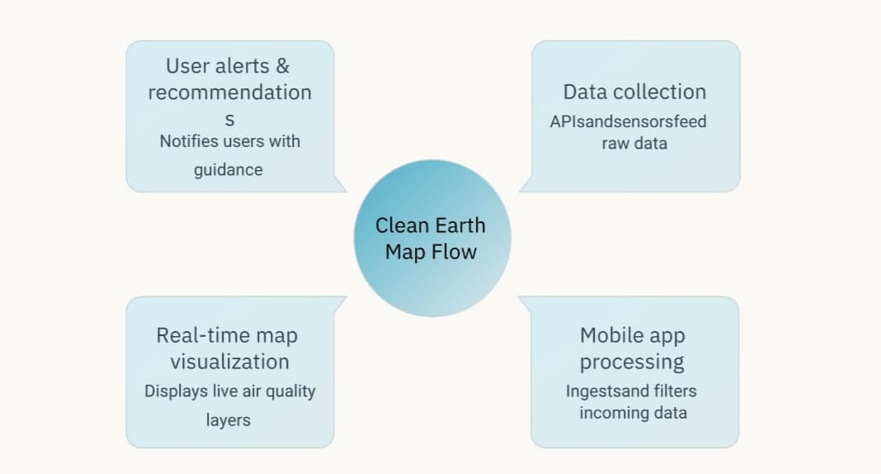
System Architecture
Our comprehensive platform integrates multiple data sources to provide accurate, actionable air quality information directly to users mobile devices.

Slide 5
MVP Features
Real-Time AQI
Integration
Live Air Quality Index data
sourced from reliable open APIs
and government databases
Core Mobile Application
Cross-platform app with intuitive map-based interface for easy navigation
Intelligent Alert System
Automated notifications for
high-pollution zones and health risk warnings
Community Reporting
User-generated pollution reports
to enhance data accuracy and
coverage

Slide 6
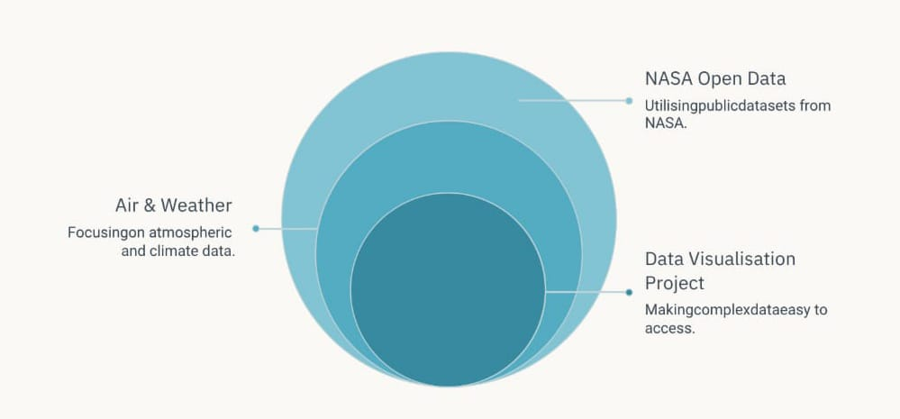
How NASA helps us?
Our vision: Help users make informed decisions and explore NASA data in a simple, friendly way.
Together Building a Cleaner Future
Air pollution is an urgent global crisis 4 Clean Earth Map empowers communities to monitor, predict, and actively reduce environmental harm through technology and collective action.

Slide 7
Future Extensions
AI-Powered Predictions
Machine learning algorithms to forecast pollution levels and weather impacts
Government Collaboration
Partnership with city authorities for policy implementation and urban planning
Thank you for your attention. Let's work together to create cleaner, healthier communities for future generations.

